Slide 1
Creating a First Python Script
Chapter 3 of Toms

Slide 2
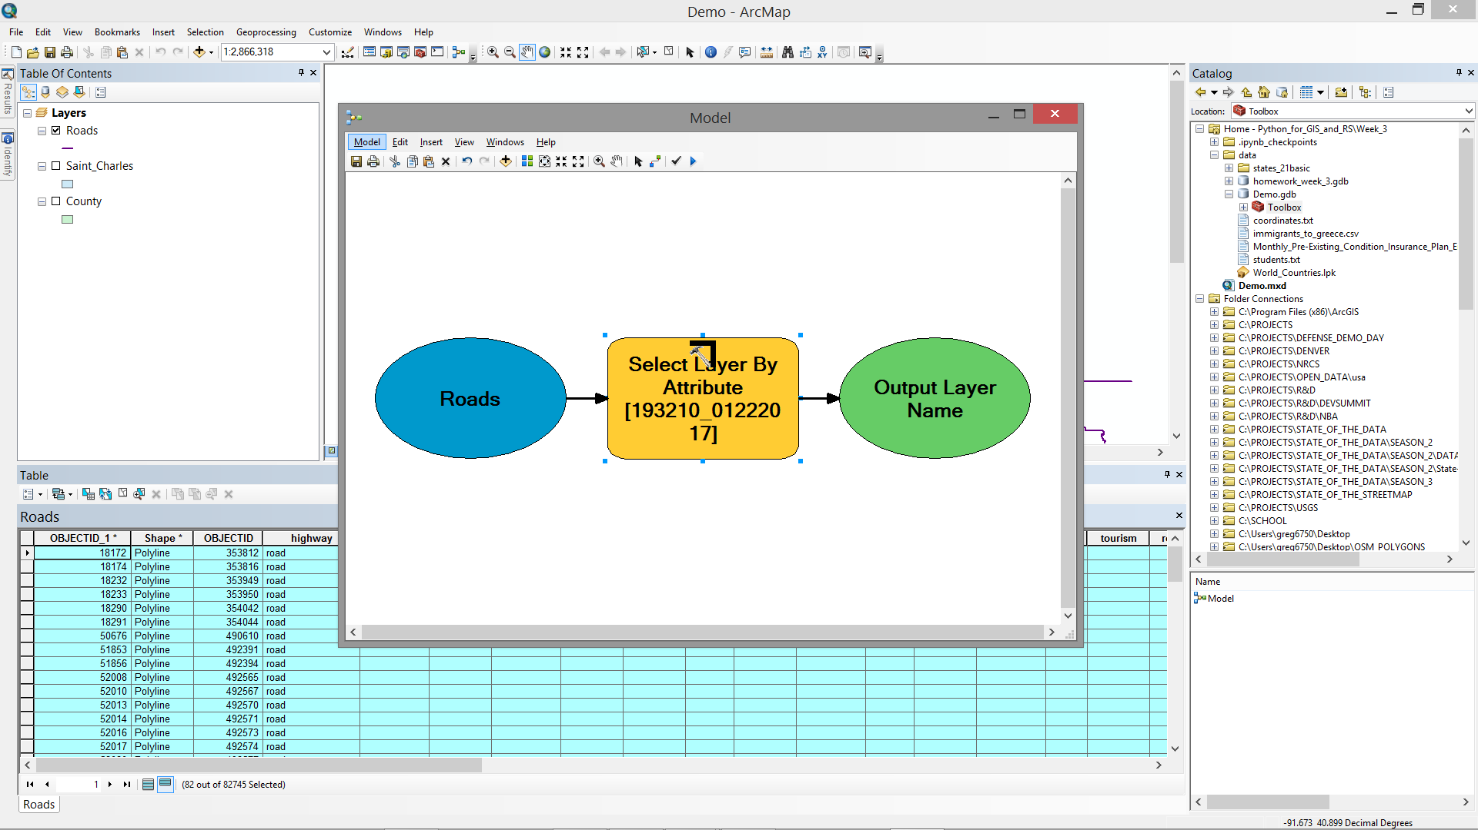
ArcGIS ModelBuilder

Slide 3
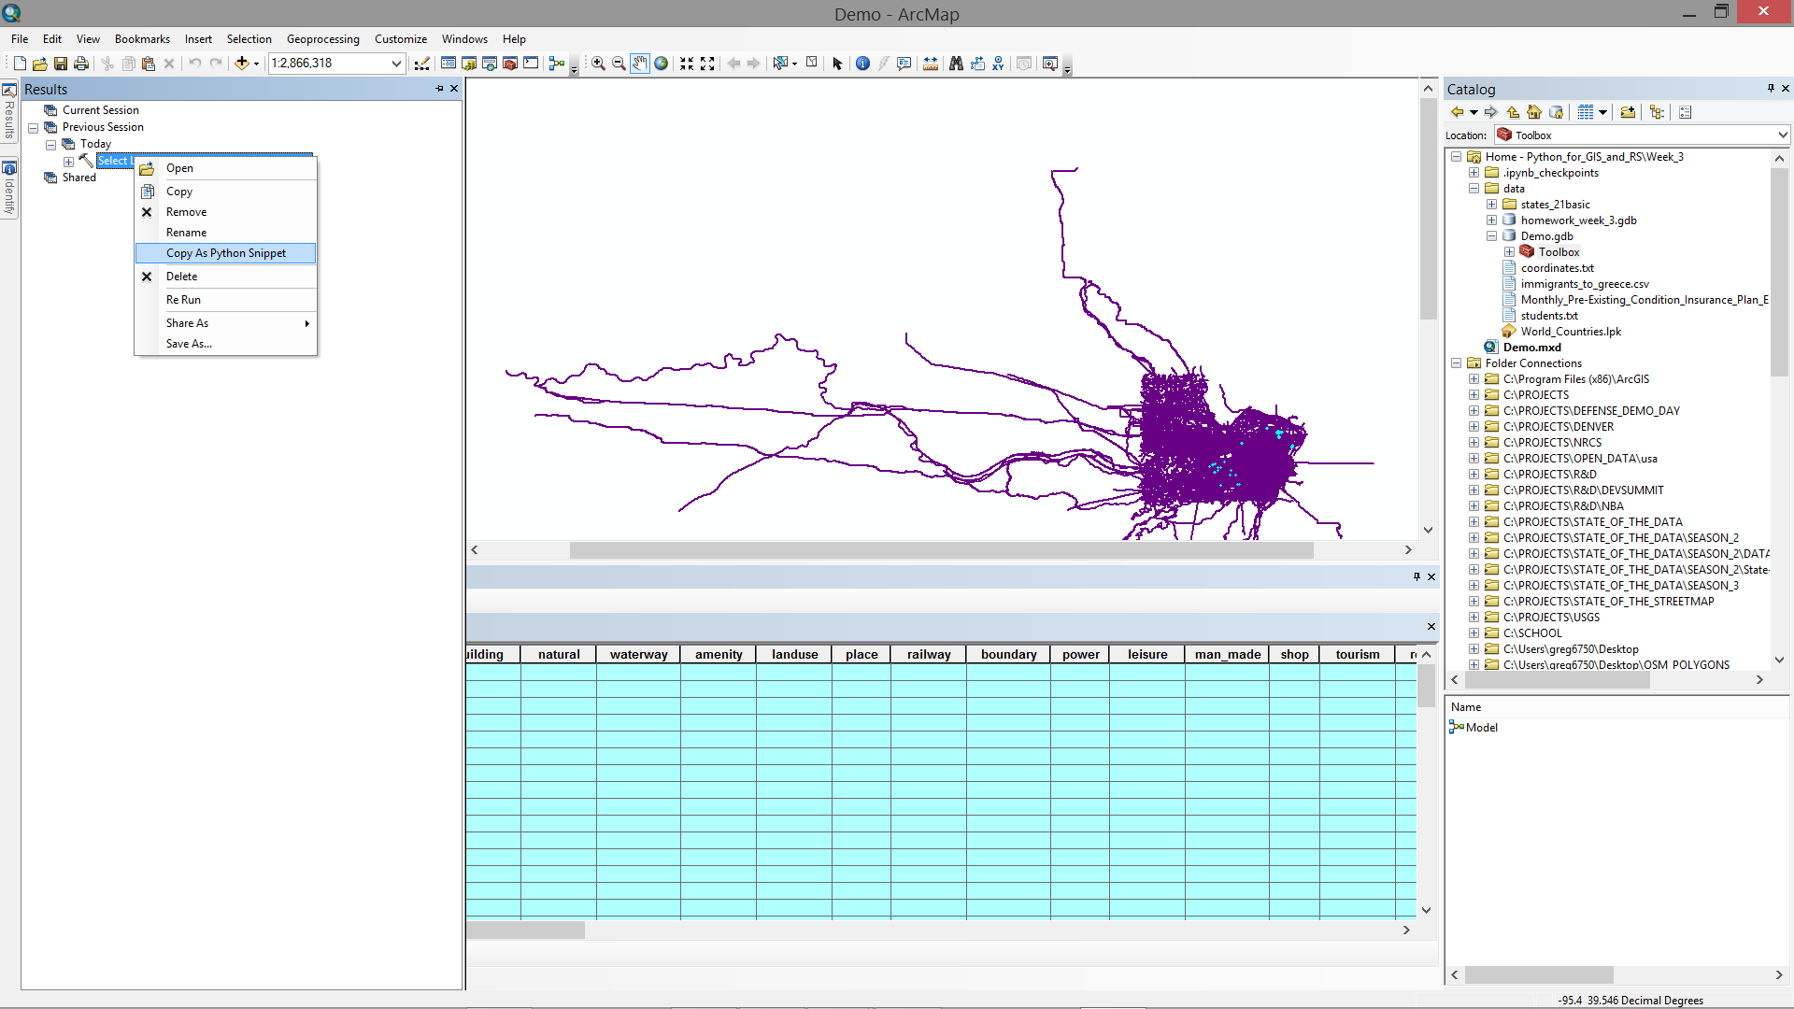
Exporting a Model as Python Code

Slide 4
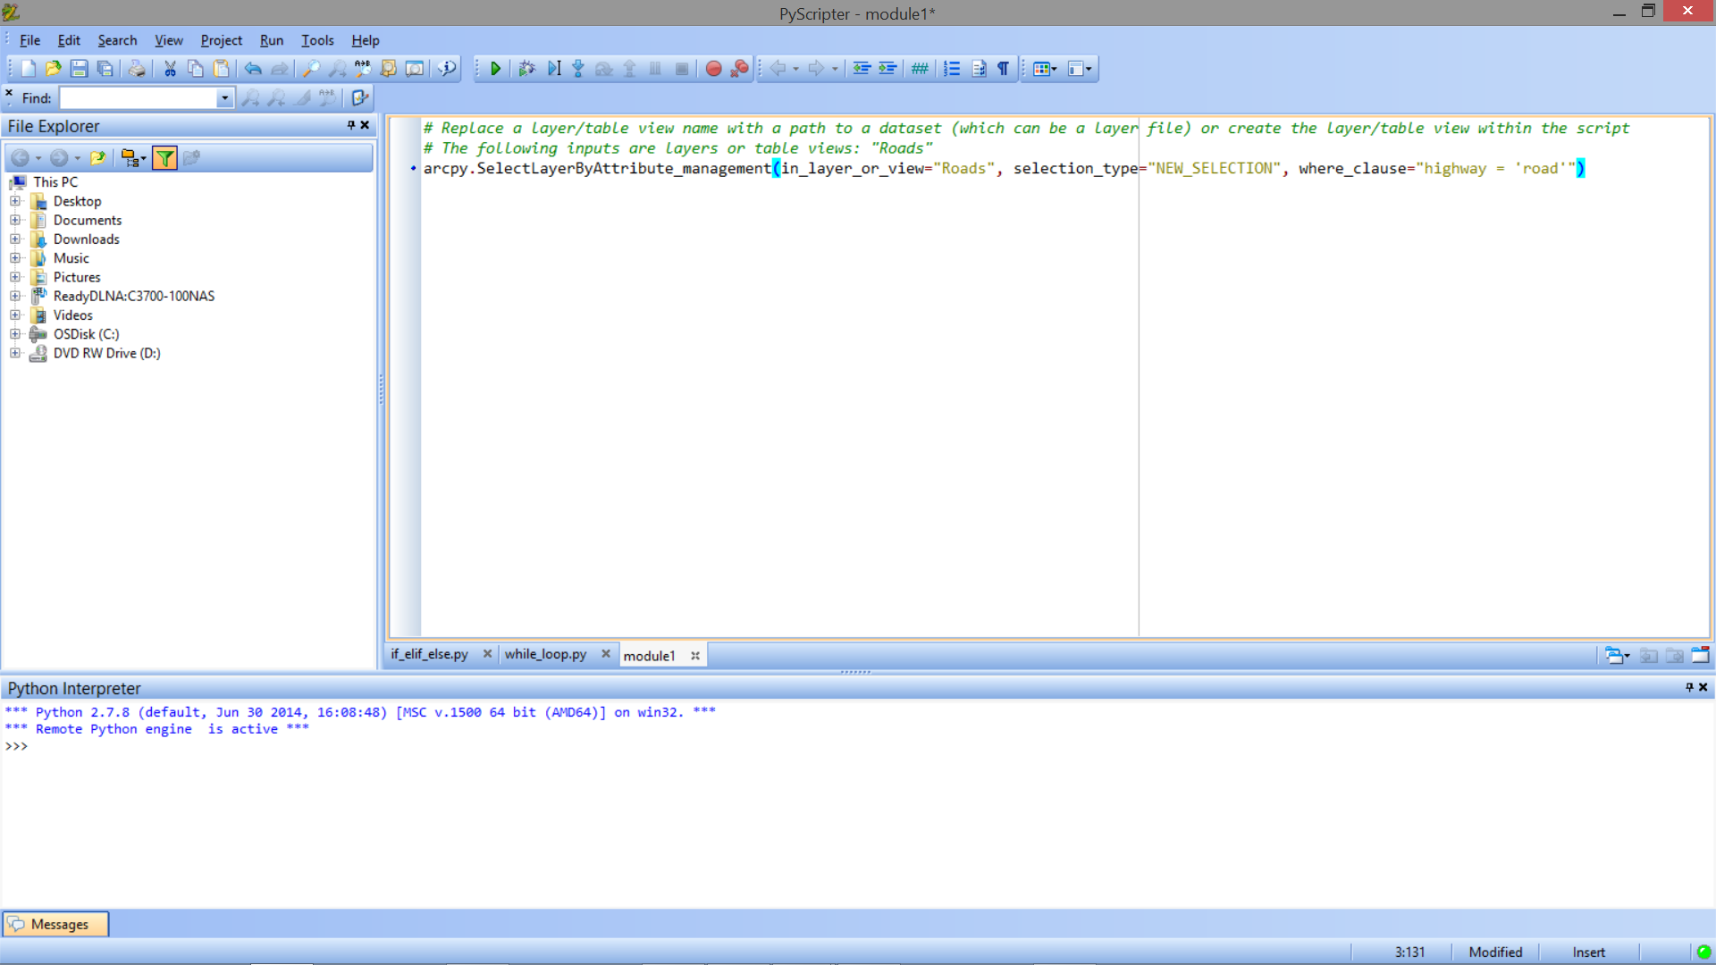
Exporting GP Results as Python Code

Slide 5
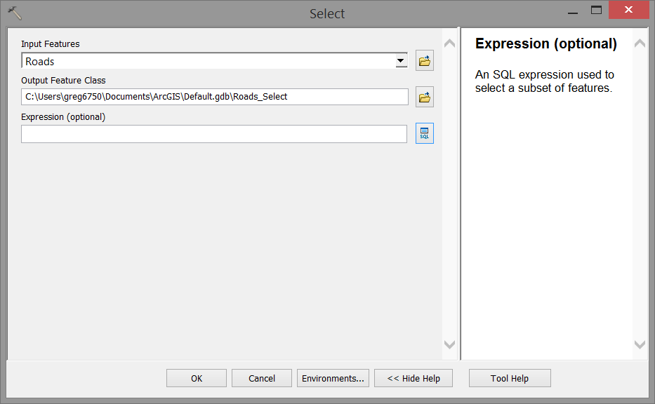
The Select Tool

Slide 6
SQL
Structured Query Language
Pronounced “ess-que-el”
Standard Language for relational database management systems
Basically, typical way to query data in a relational database

Slide 7
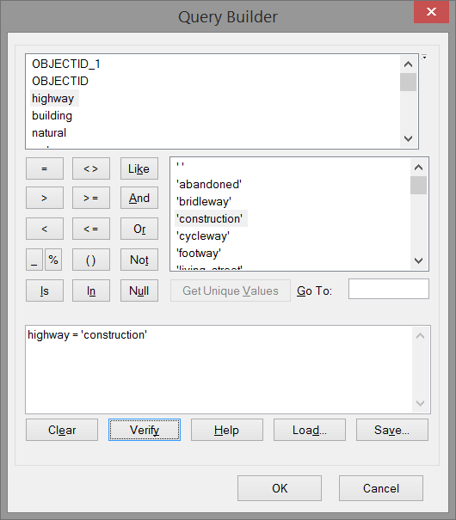
Query Builder in ArcGIS

Slide 8
Demo – Select Tool
Run Tool
Define parameters
Define SQL query
Export Result as Python Snippet
Show Python snippet in Python IDE

